Slide 1
RECOMMENDATION ON DEVOTIONAL MUSIC TO USERS
MENTOR:
Ms. Bhanupriya
DATE : 08.12.2021
TEAM 2 :
Garima Soni
Dhanalakshmi S
Ashutosh Singhal
Prashanth L M
Koushik H V

Slide 2
BUSINESS PROBLEM Recommendation Engine for a Devotional Songs Music application targeted for Indian users.
OBJECTIVE
The aim of this project is to build a feature of recommendation system to support a music app.

Slide 3
What and why is Recommendation System?
Recommendation systems are the systems that are designed to recommend things to the user based on many different factors. Companies like Netflix, Amazon, etc. use recommender systems to help their users to identify the correct product or movies for them.
Music dataset is too big while life is short!!!! You need someone to teach you how to manage and give you wise suggestions according to your taste!
Classifying different types of recommender systems :
Collaborative Recommender System:
User-User collaborative filtering
Item-Item collaborative filtering
Content based Recommender System.
Demographic based Recommender System.
Utility based Recommender System.
Knowledge based Recommender System.
Hybrid Recommender System.

Slide 4
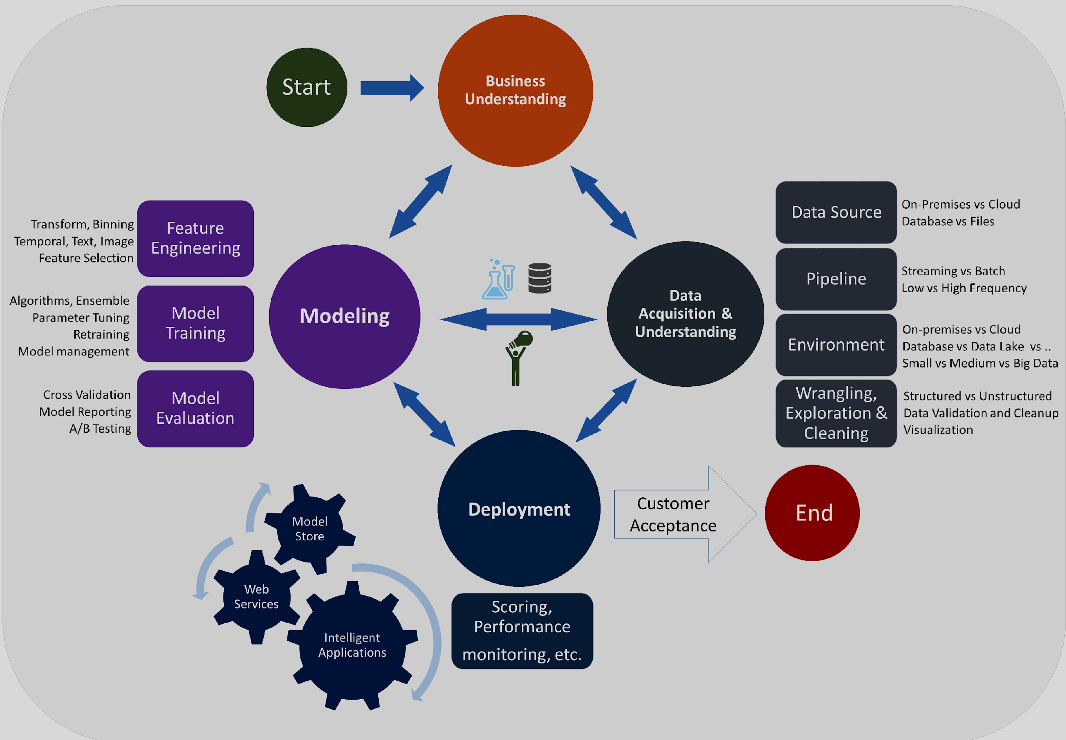
DATA SCIENCE LIFE CYCLE

Slide 5
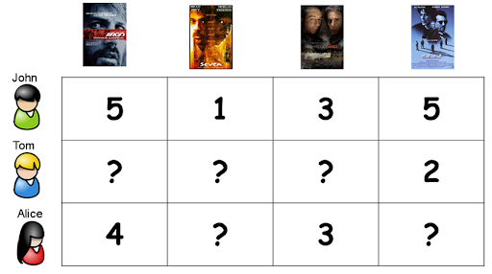
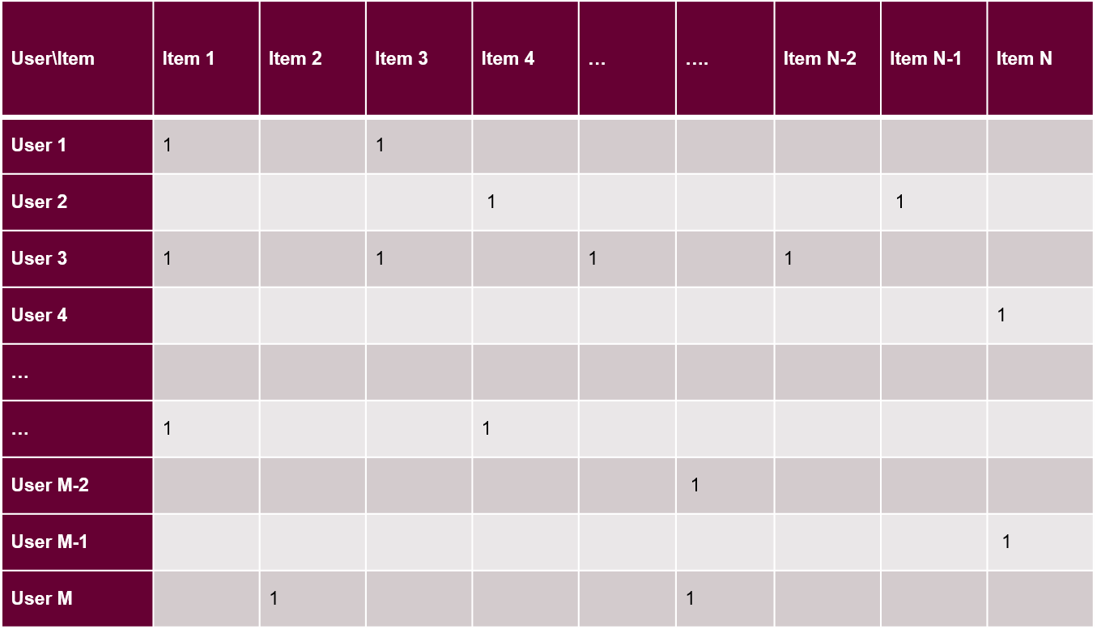
DATA ACQUISITION ON FEEDBACK
Explicit Feedback:
For example, ratings on a scale of 1-5
Positive as well as negative preference are known
Downside : Not easily collected , users do not update ratings
Implicit Feedback:
For example, user activity, purchase history
Negative preference are not known
Advantage : can easily be collected , truly reflects the users preference.
Hybrid Feedback:
Hybrid Feedback uses both explicit and implicit feedback to maximize prediction quality

Slide 6
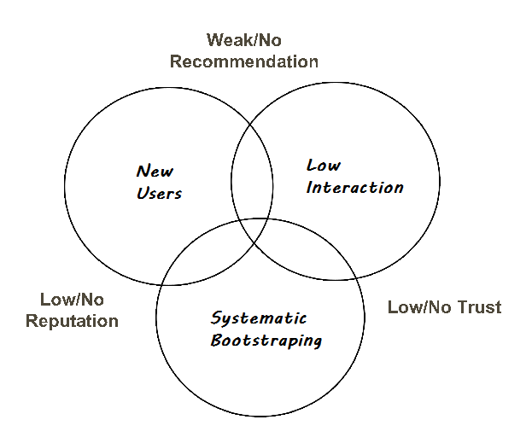
HANDLING THE COLD START PROBLEM
The recommender system face a problem when there is very little data available related to the user or item. There are two types of cold-start problem:-
User cold-start problems
Product cold-start problems
REASONS:
Mitigation Technique
Representative Approach
Feature Mapping
Hybrid Approach

Slide 7
ACTION PLAN
Data Preparation
Data Collection from Spotify
Exploratory Data Analysis
Deployment
Data Visualization
Evaluation
Model Building

Slide 8
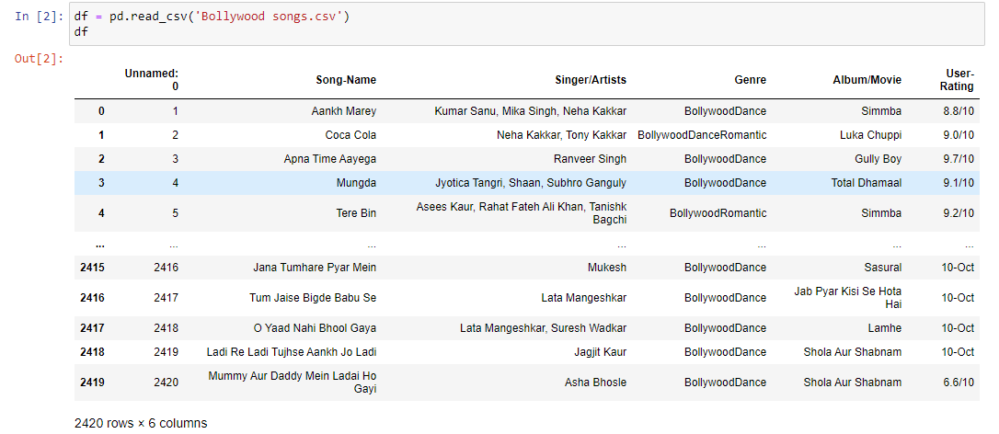
DATA COLLECTION
We have collected the dataset from Spotify

Slide 9
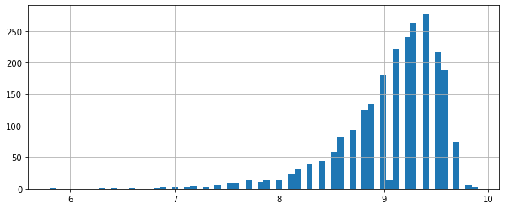
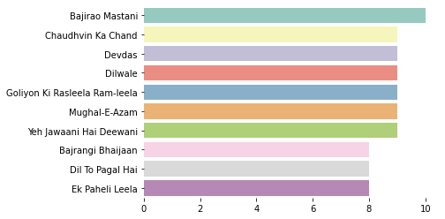
EXPLORATORY DATA ANALYSIS
check the distribution of the rating
Top ten songs

Slide 10
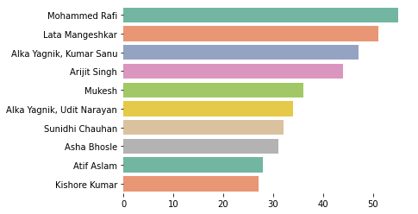
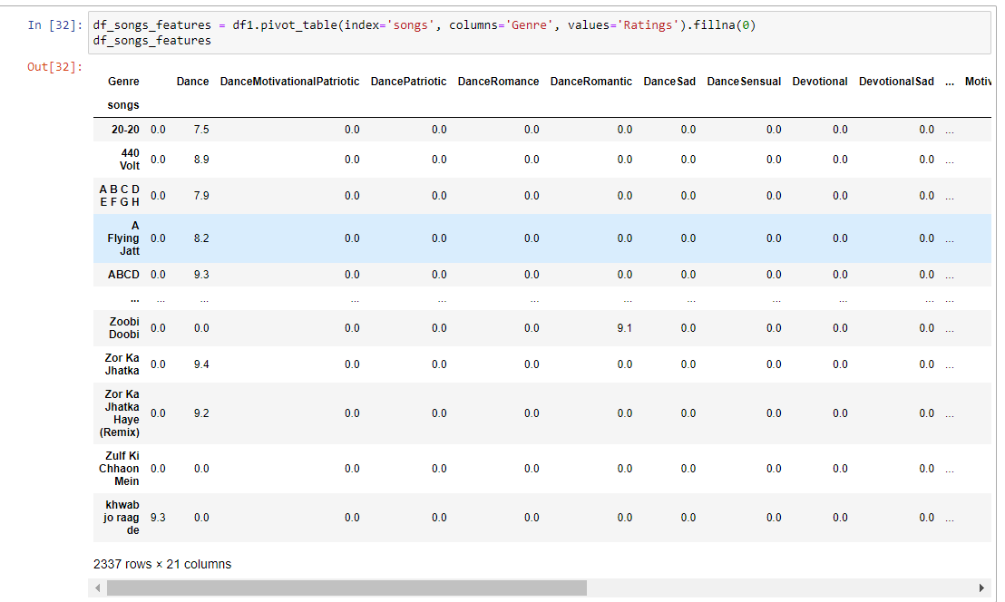
USER BASED COLLABORATED FILTERING
Top pop artists
converting long data into wide data using pivot table

Slide 11
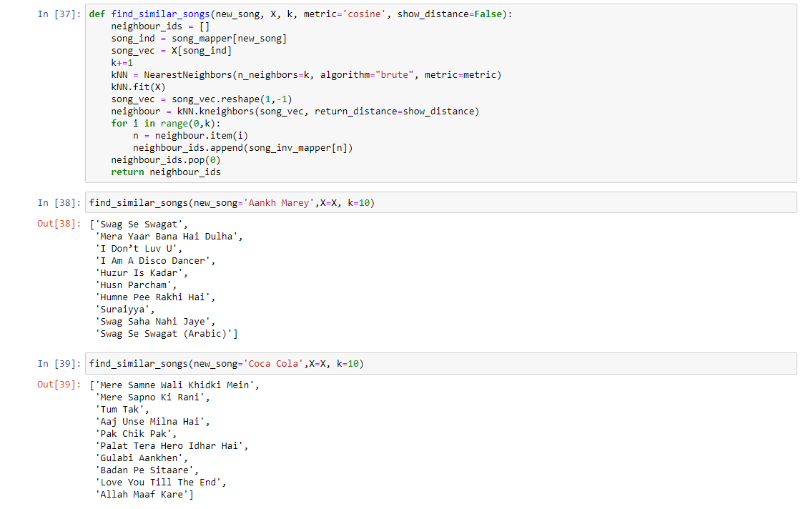
USER BASED COLLABORATED FILTERING
Find similar songs

Slide 12
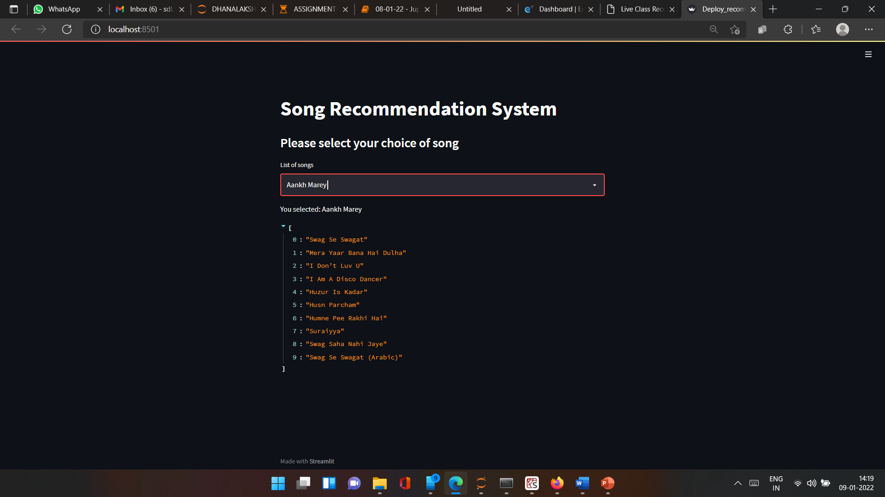
USER BASED COLLABORATED FILTERING
PROJECT-music-recommendation/music_recommendation.ipynb at main · sdlapril/PROJECT-music-recommendation (github.com)
Codes
Deployment with Streamlit

Slide 13
THANK YOU

